Slide 1
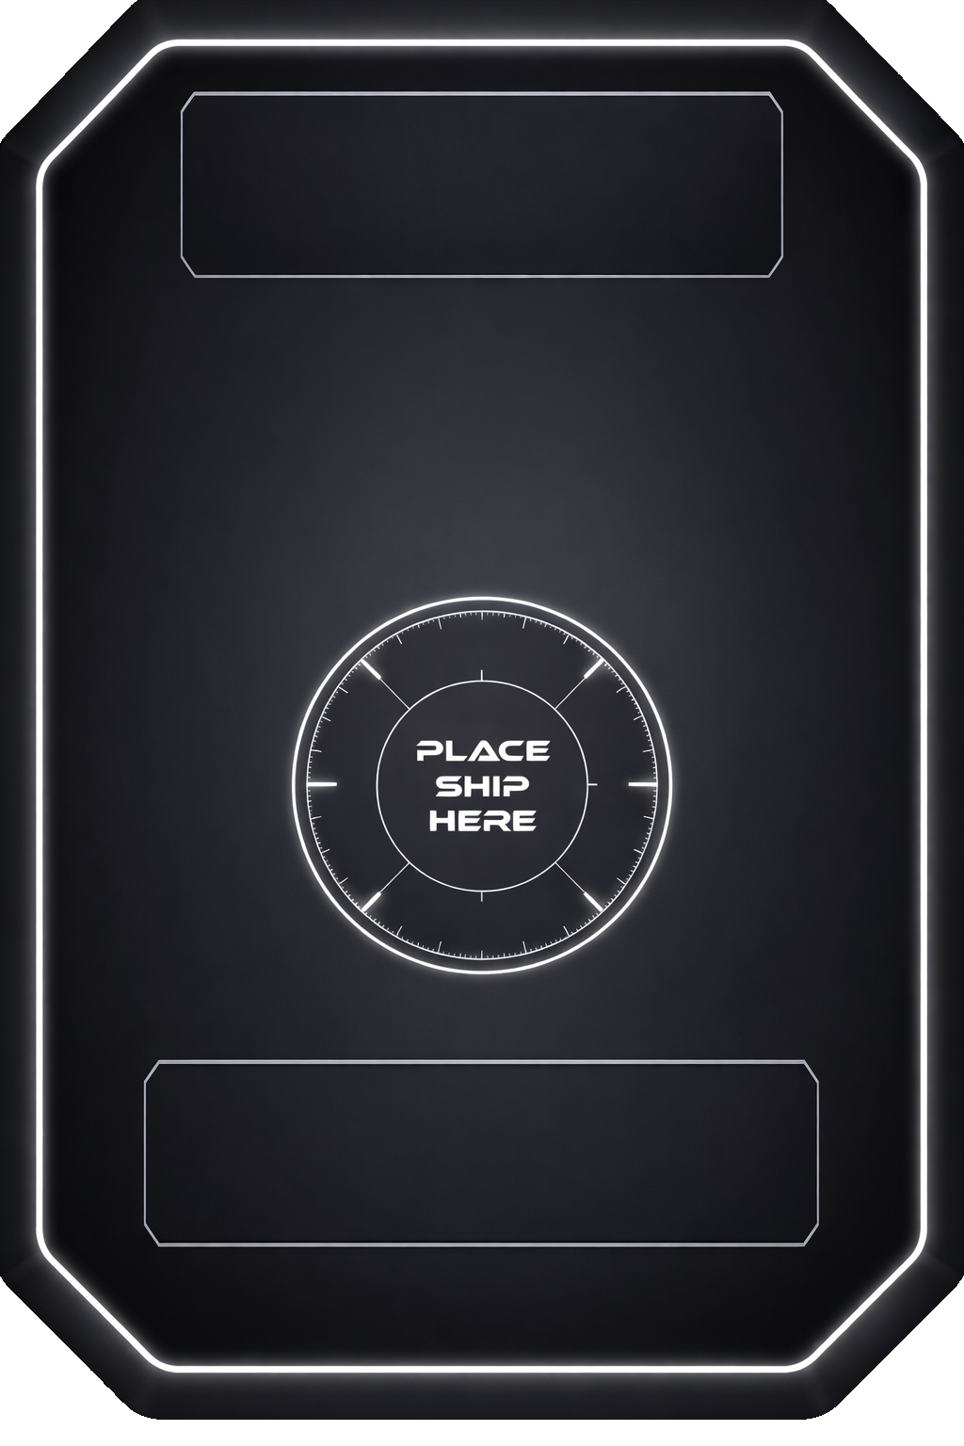
UPGRADE NAME
EFFECT
AVAILBLE TO
SHIPS ABLE TO take this upgrade
1

